Slide 1
illumination
Sprint 0
By Team 1 Tech Titans

Slide 2
Agenda
Team Members | Names of team members involved in the project.
Problem Statement | The challenge or issue the project addresses.
Project Description | Brief overview of the project's purpose and functionality.
Personas | User profiles representing target audience.
Technologies | Tools, frameworks, and platforms used in the project.
Algorithms | AI/ML models implemented.
Project Schedule | Timelines of the project.
Team Working Agreement | Rules and expectations for team collaboration.
Retrospective & Wiki Page Link | Reflections on project progress.

Slide 3
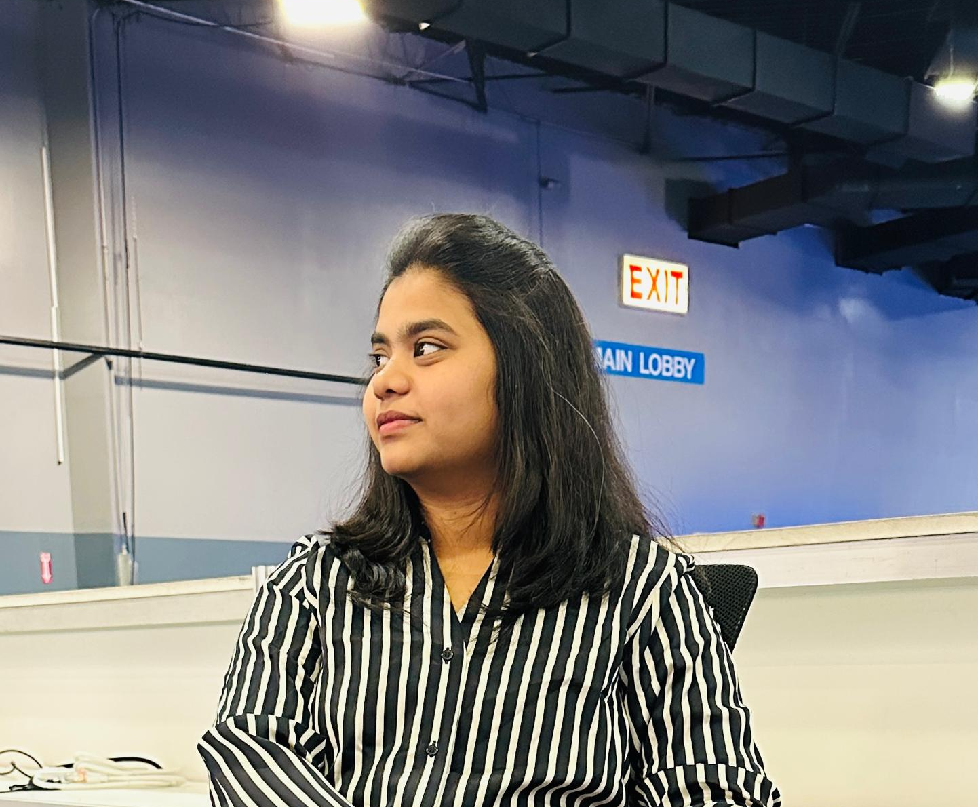
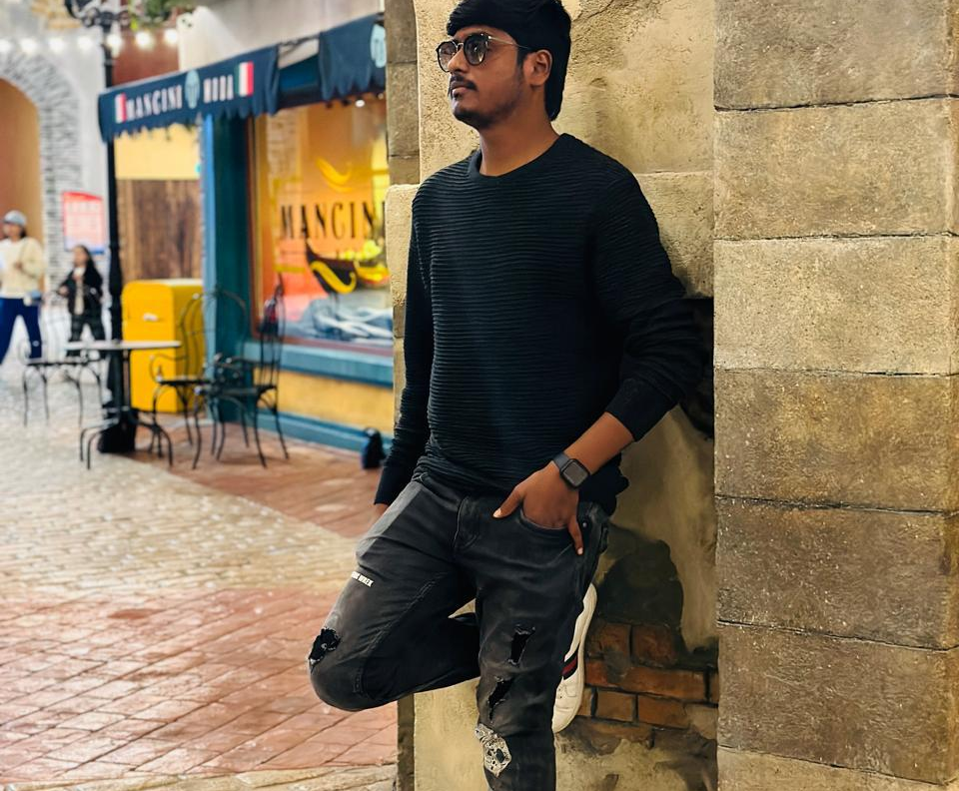

Team Members
Anuhya Marapalli
Rithin Guptha Bajuri
Snehalatha Boothpur
Scrum Master / Developer
Developer
Designer / Developer

Slide 4


Team Members
Harshitha Rangaraju
Srinivas Reddy Bapathu
Developer
Developer

Slide 5
Problem Statement
So there is always an issue in learning because the present education system is a fit system where all students with different ways of learning or understanding, were taught in the same manner which causes some to understand it very well whereas some are unable to understand it well. This leads to a loss of interest and focus for those who genuinely want to learn.

Slide 6
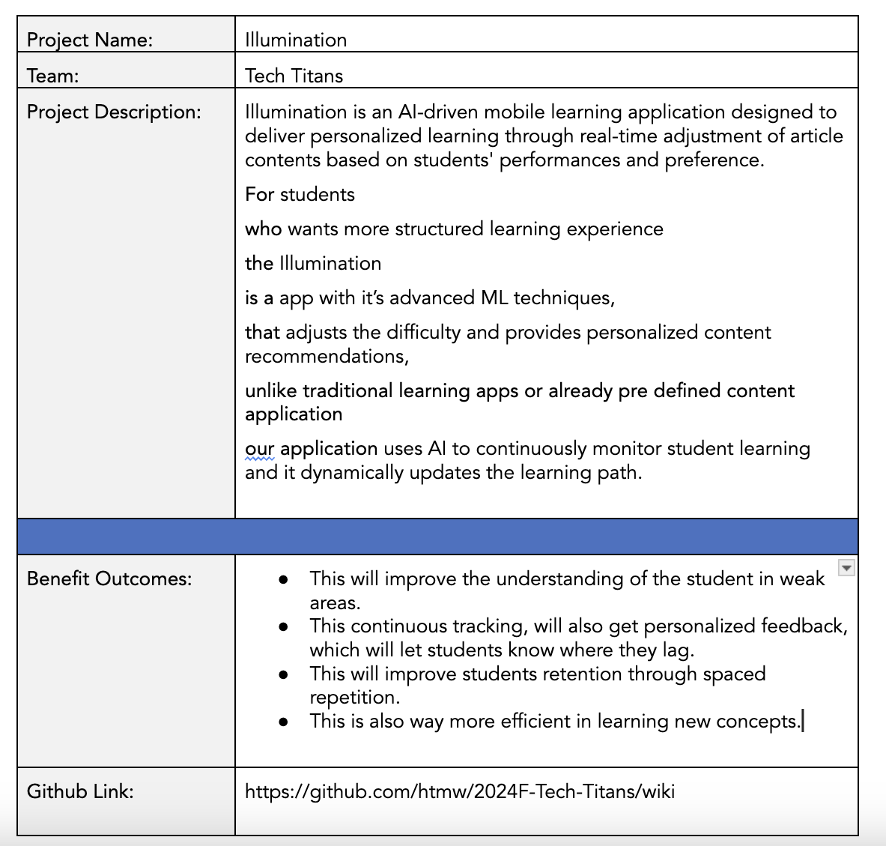
Project Description
BRAND NAME

Slide 7

Ankit, 17 year old
Ankit is a high schooler who is preparing for IIT JEE exams where is he good at Mathematics and Chemistry but he struggles in Physics, even though he attends extra classes, but he never excels it. So, he feels like he personalized study material to improve his weak areas.
Goals:
Have good grasp on difficult physics topics.
Have access to personalized materials on complex topics or topics where he is weak at.
Able to balance school, extra classes and self study.
Challenges
There is a lot of content in online or in books but unable to find proper content for his weakness topics.
Searching for proper material is time taking.
Unable to identify the weak topics.

Slide 8

Rajat, 28 year old
Rajat is CA (Chartered Accountant) aspirant from Mumbai, but he is also working full time in financial firm, which causes him have less time to study. He finds financial reporting and taxation difficult and even struggling to focus because of tight schedule.
Goals:
Improve the understanding of the complex topics.
Able to access the targetted material on the topics which he finds difficult.
Able to balance both work and preparation.
Challenges:
Its difficult to manage both work life and student life which leading him not to study well.
Time consuming on finding the concepts he is weak at.
Struggling to study all because of broad topics in CA.

Slide 9

Kavya, 21 year old
Kavya is engineering student, as she is near her job trails and she is interested in Machine Learning and GenAI, she want to study them and learn them, but she have no idea on machine learning. When she searching of google for roadmap, all those roadmap doesn't suit her well which causes her to distract.
Goals
Master all Machine learning and deep learning concepts.
Able to read fine quality materials which simplify the complex concepts into simple once.
Challenges
There are alot of materials on it which causes to read alot of materials of same topics to understand them.
Facing difficulties in retaining the concepts.
Unable to keep up with the latest trends on ML.

Slide 10
Technologies
01.
02.
03.
Backend
Frontend
Tools
fastAPI
Node JS
Mongodb
AWS
Pytorch
React Native
Github
Postman
Google Colab
VSCode

Slide 11





Backend
Here FastAPI is primarily used for machine learning backend tasks where as Node JS is primarily deals with Client Side code. MongoDB for Storing the data. AWS for hosting and even for storing the objective Data. Pytorch for Machine learning

Slide 12

2. Frontend
React Native is used for building cross platform mobile application.

Slide 13




3. Tools
Github is where code and even the documents are shared. Postman is for API Testing. Google Colab for training the Machine Learning Model. VSCode is used for writing the code

Slide 14
Algorithms
Reinforcement Learning
Reinforcement Learning (RL) is a machine learning paradigm where an agent learns by interacting with an environment and receiving rewards for actions. In adaptive learning, RL is used to dynamically adjust content difficulty based on student responses, maximizing engagement and learning efficiency over time.
Word2Vec
Word2Vec is a deep learning-based model that transforms words into continuous vector representations, capturing semantic relationships between words. In content-based filtering, it is used to convert textual content (article text) into vectors, allowing us to measure similarity between content items. Similar vectors imply similar content, enabling personalized recommendations.

Slide 15
Project schedule
Stages | Sept | Oct | Nov | Dec
Sprint 0
Sprint 1
Sprint 2
Sprint 3

Slide 16
3 times a week
Team Meeting will be held

Slide 17
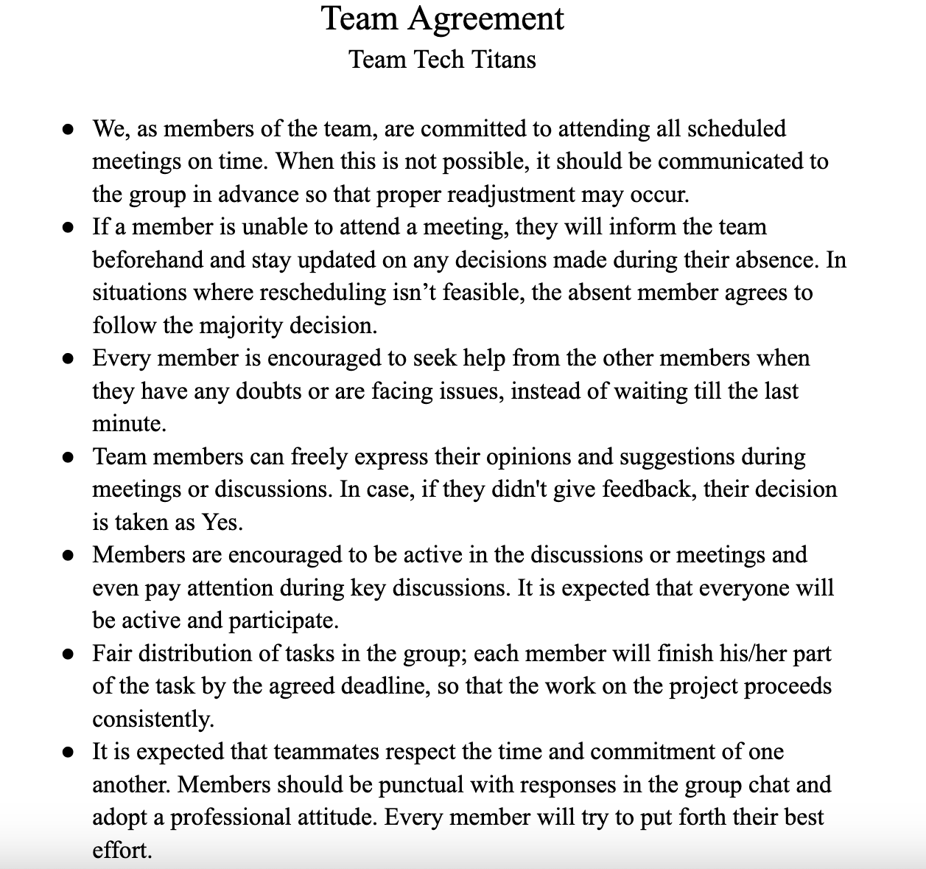
Team Agreement

Slide 18
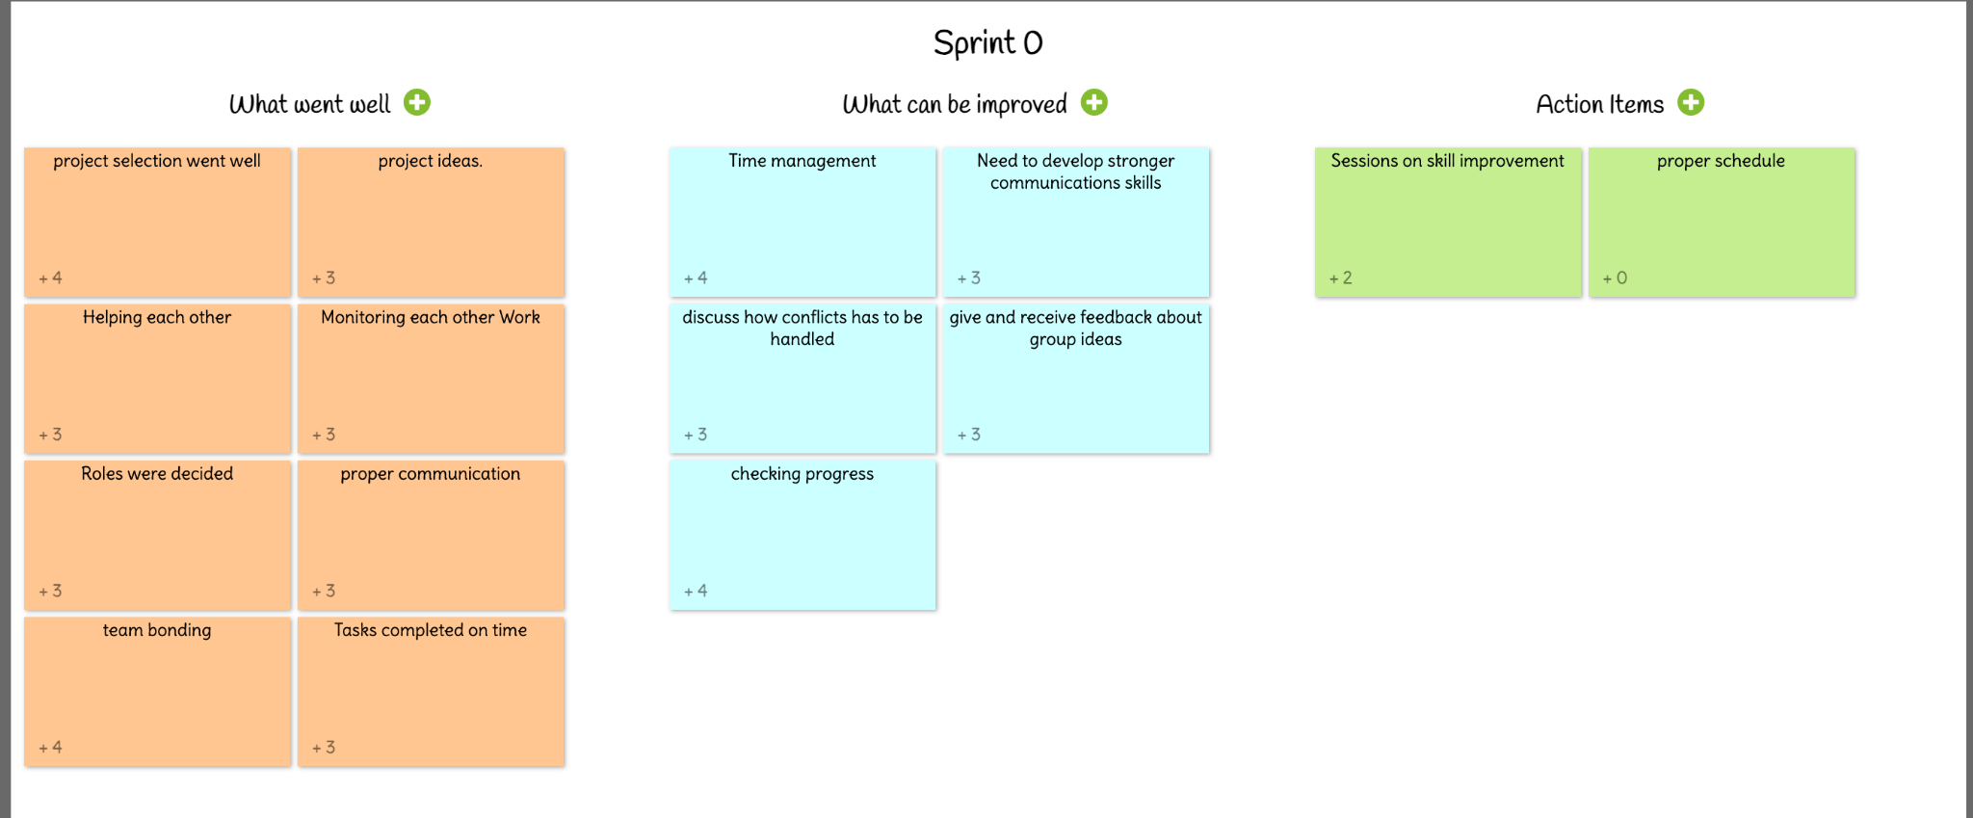
Retrospective

Slide 19
Wiki Link
https://github.com/htmw/2024F-Tech-Titans/wiki

